Slide 1


Pratik Gami
Portfolio

Slide 2




approach
1
USER AWARE
EMPATHY
CRAFTED
INSIGHT DRIVEN
Know your Audience
For users and co-workers
One size does not fit all
Contextually responsive.
Also to understand the user-product/service interaction, it’s always good to kept in mind the following product/service life cycle:
AWARENESS
CONSIDERATION
INTENT
PURCHASE
CONSUME
MANAGE
LOYALTY
SHARE

Slide 3
HIGH-LEVEL PROCESS
2
Follow a structured process that relies on research to understand user needs and aspirations, and stakeholder views. It also looks at what's in the market. Design directions are drawn up based on inferences from research. Concept designs are then validated and detailed out before building the front end code.
Research
Ideation
Interaction Design
Visual Design
UI Engineering
May
2012
May
2012
Jan 2014
Nov 2015
Bachelor of Engineering
Information Technology
User research
Persona & scenarios
Eco-system research
Competition analysis
Stakeholder Interview
UX Review
Brainstorming
Concepts
Formative UT
Information Architecture
Wireframes
Interaction designs
Mock ups
Formative UT
Mood boards
Branding
Graphic Design
Illustrations
Formative UT
Prototype
Maintenance
Summative UT

Slide 4
2012
2013
2014
2015
2016
2017
2018
My first job at Oracle Financial Services Software as an Associate UX Developer
Led a team of researchers, UX designers and visual designers at Moonraft Innovation Labs in the capacity of Lead Designer
Graduated with a bachelors degree in information technology engineering
Worked at Human Factors International as a UX consultant.
Worked at Human Factors International as a UX consultant.

Slide 5
2012
2013
2014
2015
2016
2017
2018
Associate UX Developer
Oracle Financial Services Software
Mumbai, India
Design Lead
Moonraft Innovation Labs
Bangalore, India
Intern – UX Design and Research
Viasat Inc.
Carlsbad, CA, USA
Information Technology
Bachelors of Engineering
University of Mumbai Mumbai, India
Human Factors Specialist
Human Factors International
Mumbai, India
Johannesburg, South Africa
Human Factors in Information Design
Masters, Candidate
Bentley University,
Waltham, MA, USA

Slide 6
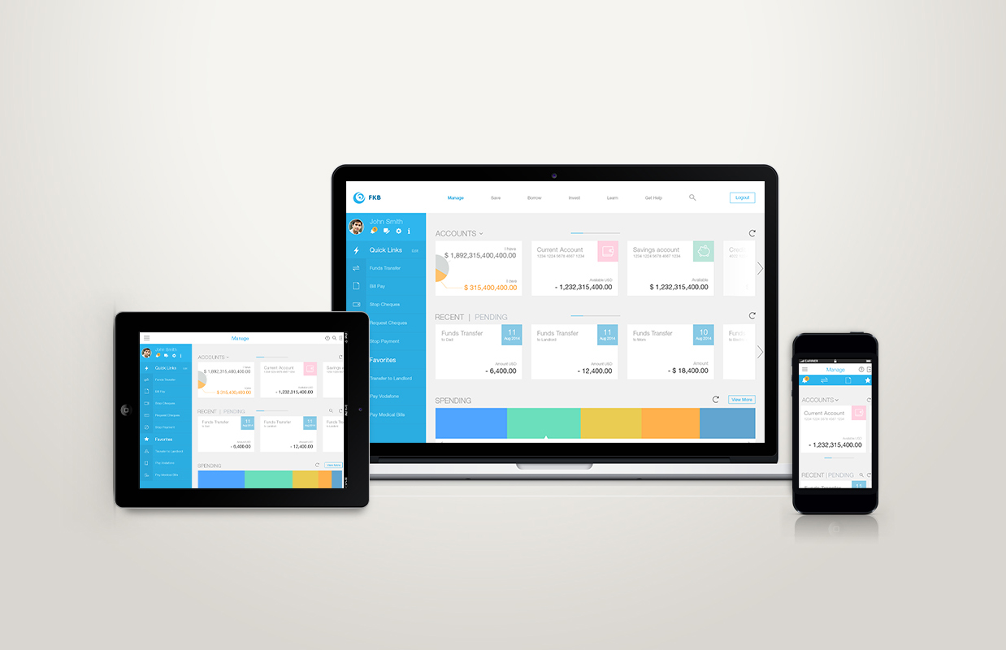
Internet Banking (Retail Customers)
3
Detailed Process
Designing for Omnipresence
The client was in process of a user experience revamp of their multichannel banking platform. We kicked offed the project with UX review, followed by tactical redesign of their existing desktop, tablet and mobile interface for internet banking.
The following slides explain the research process used for the project in detail.

Slide 7
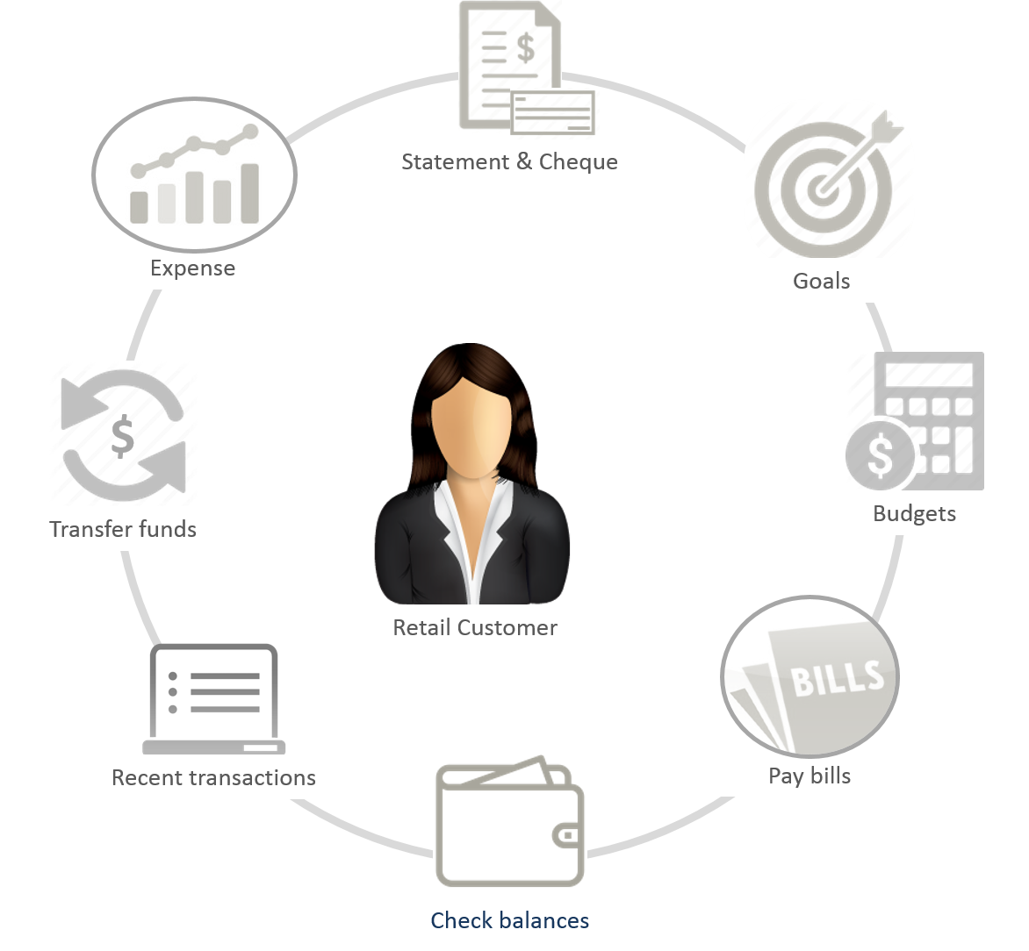









3.1
Online Banking Ecosystem
Desktop
IVR
Enable up-sell/cross sell
Push customers to use online banking
Mobile
Reduce call centre cost
Users
Bank
Tablets
Increase customer/user base
Enable users to use all features
Kiosks
Since FLEXCUBE is an off-the-shelf, white labeled product, it was critical to understand needs and behavior of both banks and end-users

Slide 8
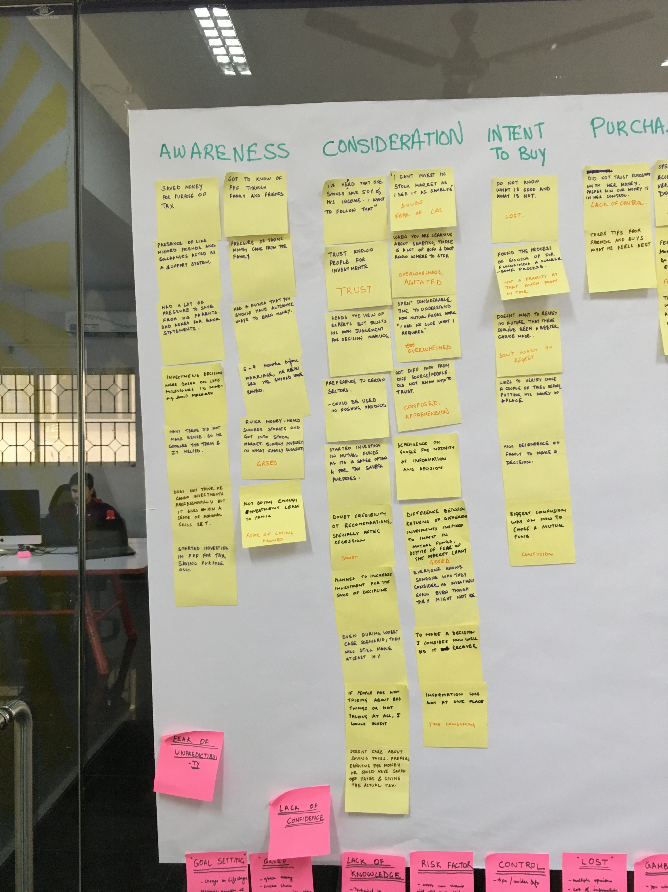
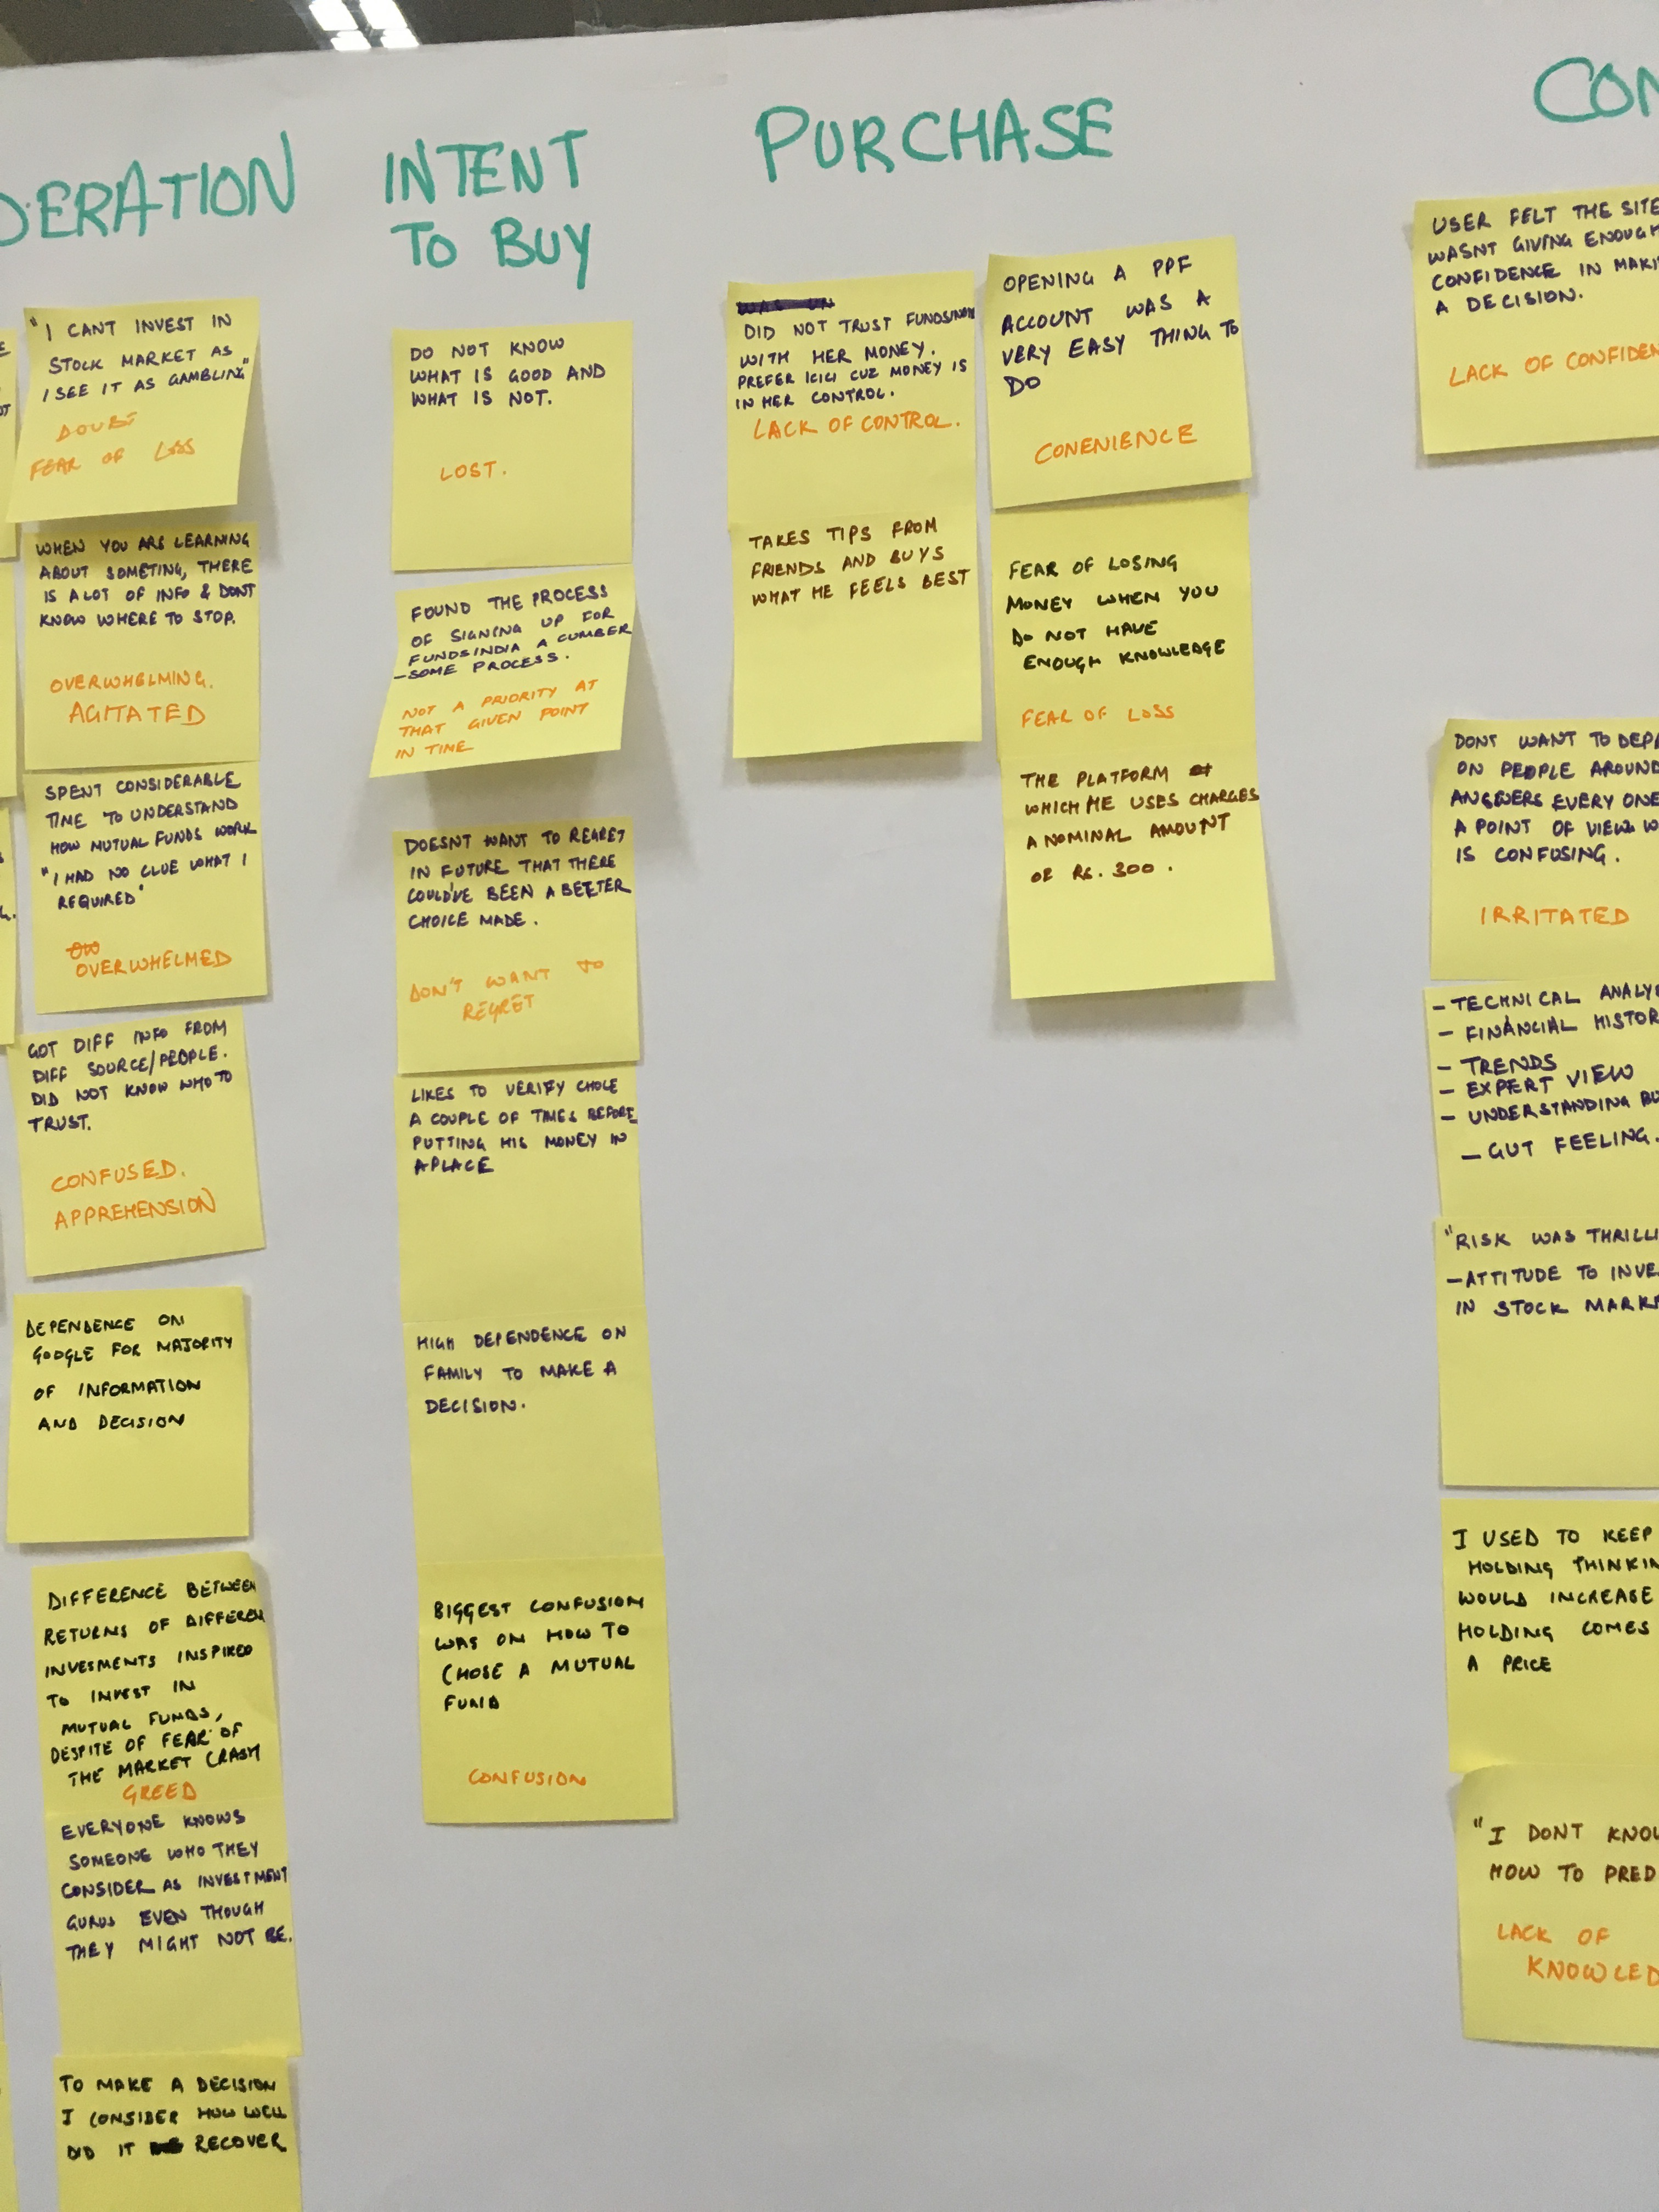
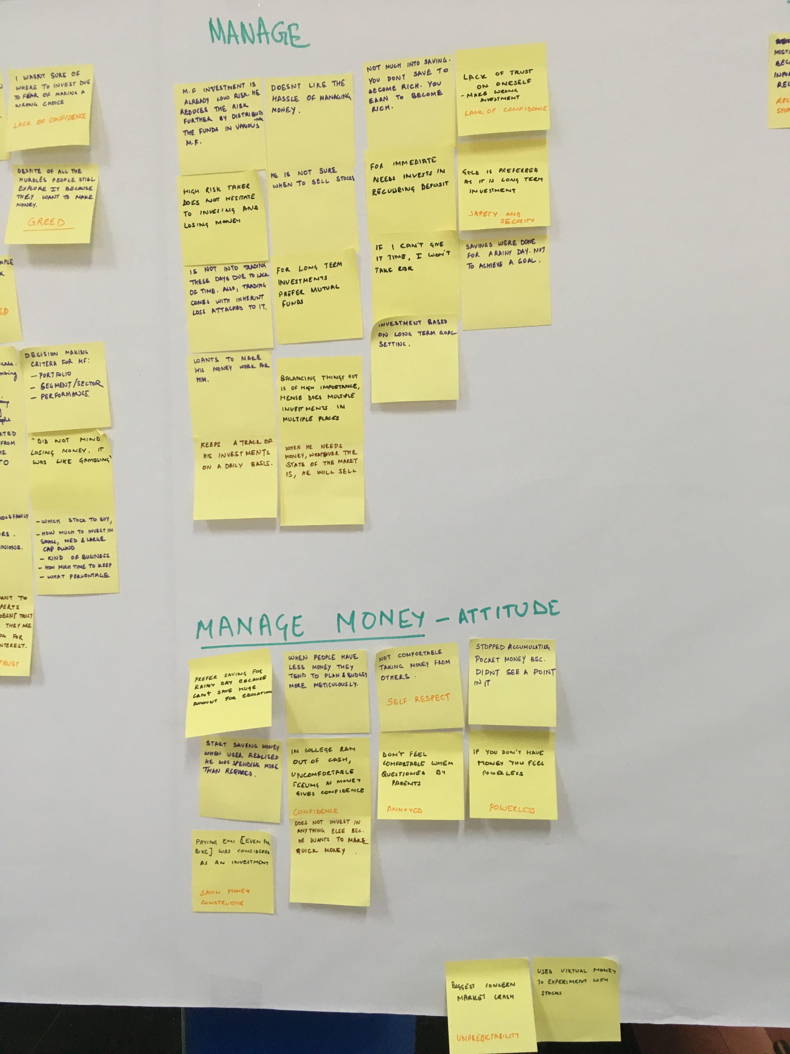
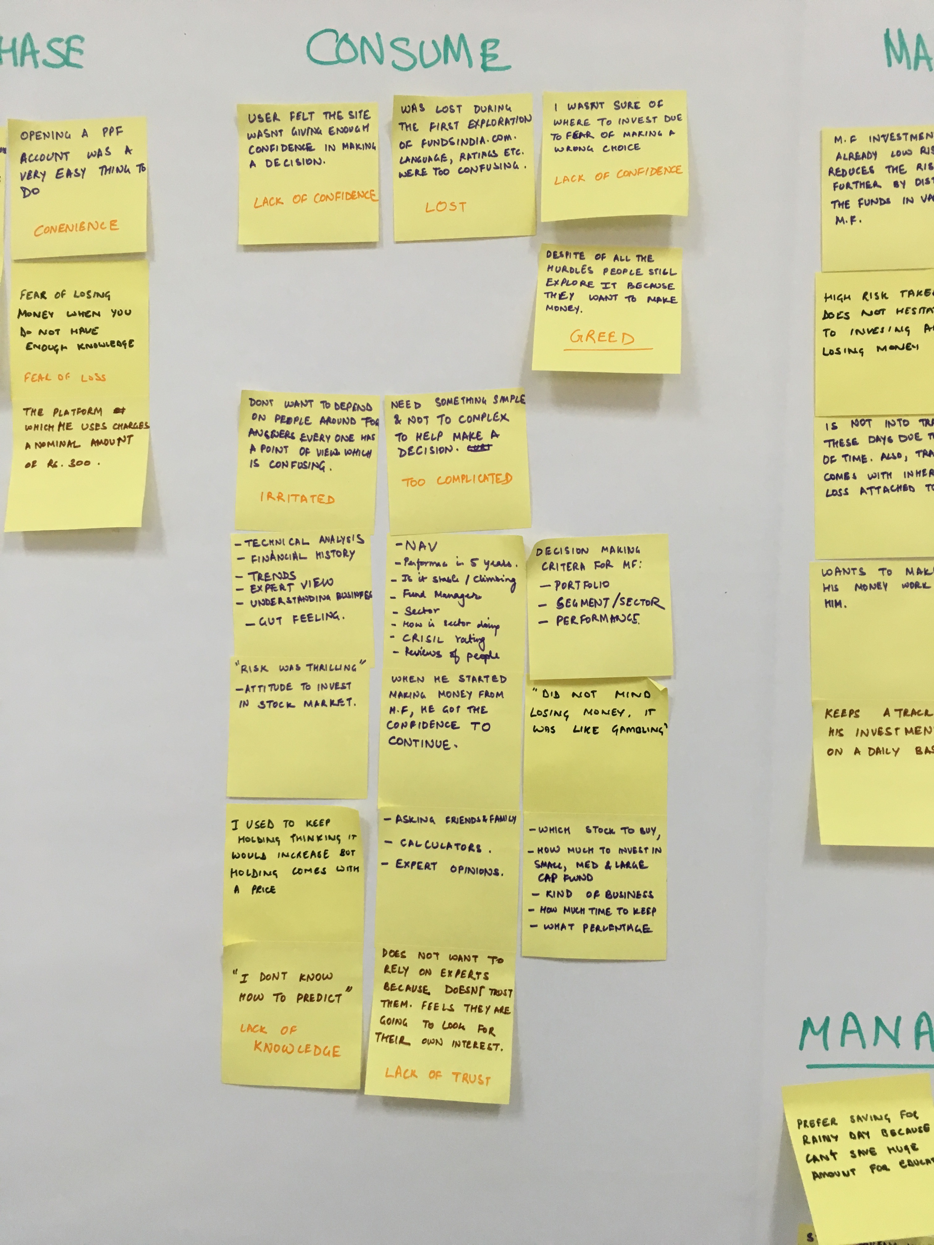
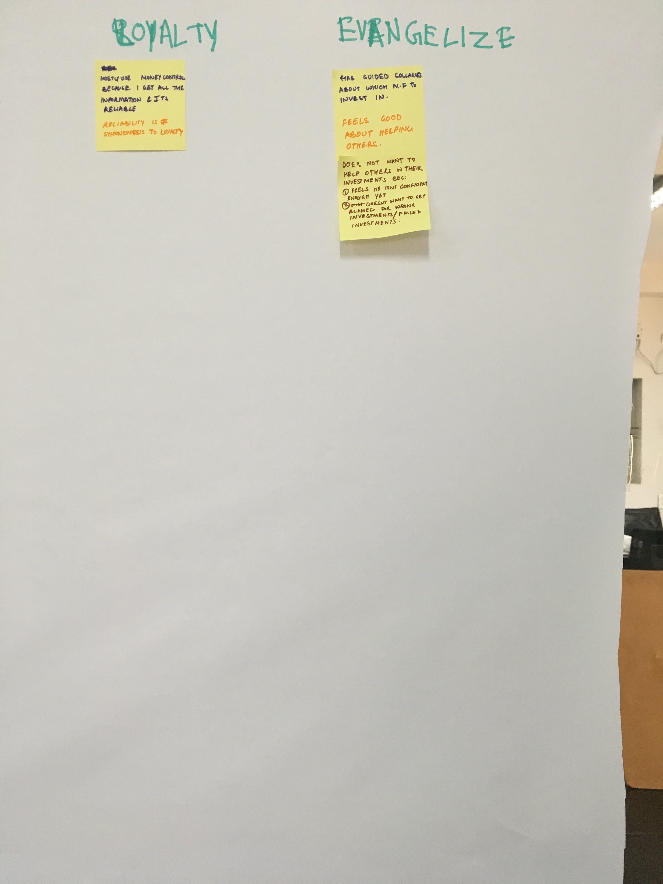
3.2
User Research
Users
Age group
Method
20
22 - 35
Interview

Slide 9
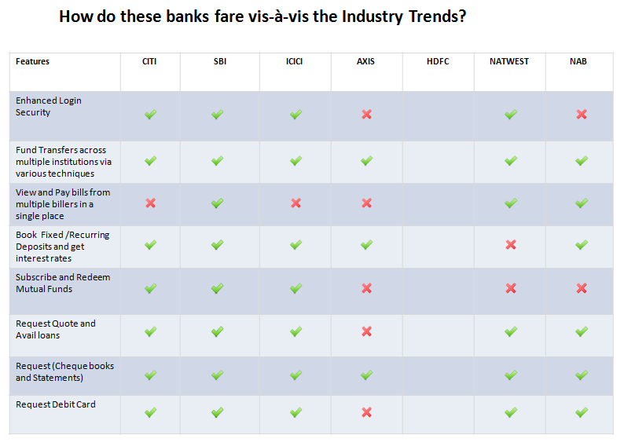
3.3
Competitive Analysis
Features
CITI Bank
SBI Bank
ICICI Bank
AXIS Bank
HDFC Bank
Natest Bank
NAB

Slide 10
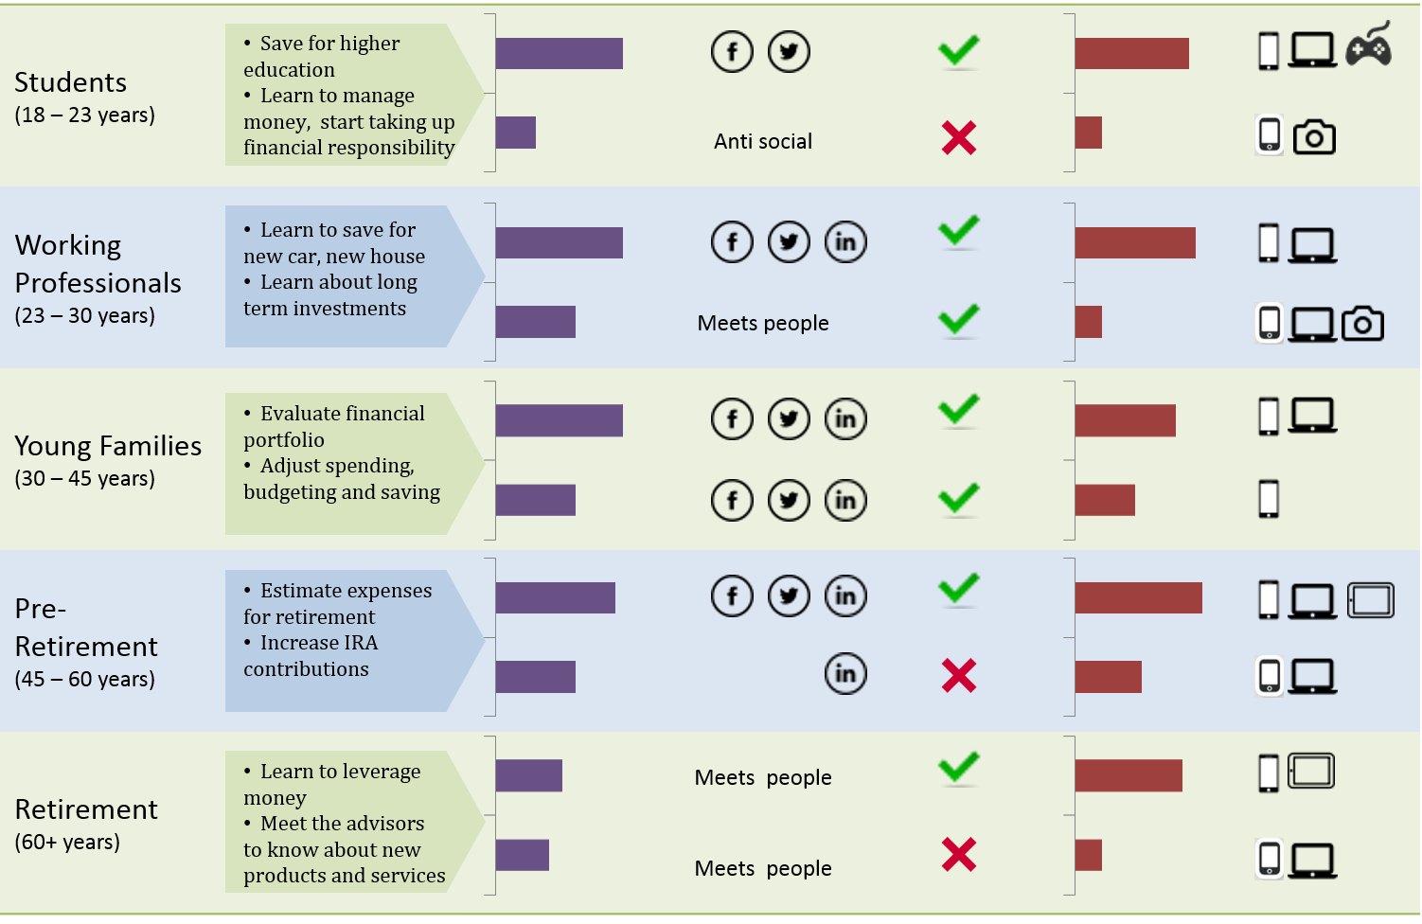
3.4
User Profiles
Common Goals
Tech Savy
Perceived Interactions
Perceived Innovation
Perceived Trust
Devices owned

Slide 11


3.5
Personas
Name: Andrew D’Souza
Age: 21 years
Lives in: India
Enjoys playing games online. Not an outdoor person at all.
Name: Mary Kate
Age: 33
Lives in: Australia
Enjoys shopping on the internet when she’s free
Andrew is a young student. He is a Senior at Delhi Republic University and will be graduating this summer.
His entire life is recorded on social platforms like Facebook and Twitter. He is a gaming freak and owns products like the XBox, Wii, iPad and iPhone
Mary Kate is a single mother of one child. She is currently working as a Marketing Manager at Summer Technologies.
Mary does a lot of online shopping and completely relies on e-commerce websites for her shopping needs.
Mary has realized that it’s important for her to get some financial advise on how to start saving for her kid’s school, college, other activities.
She has been using Internet Banking only for paying her utility bills and checking balances. She wants to start getting proactive on how to manage her finances in order to safeguard her and her child’s future
Andrew is a spendthrift, shops regularly for new games and doesn’t care a lot about money. He is soon going to start college and hence his father wants him to take responsibility and manage his own finances.
Andrew knows his way around all gaming apps in the Apple Store but has never used any banking app before.

Slide 12
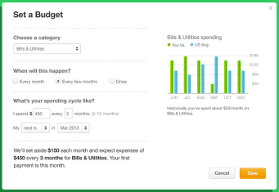
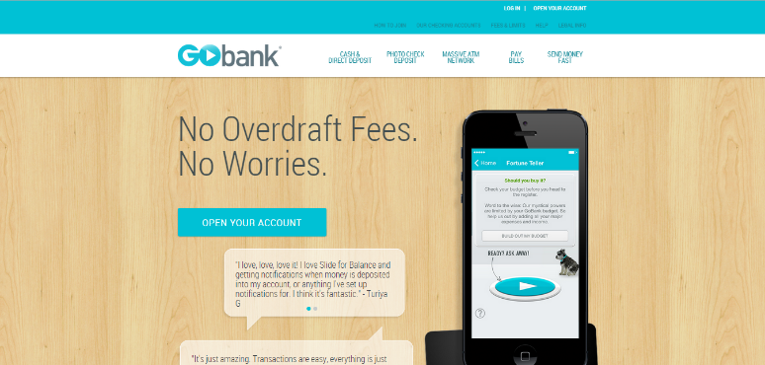
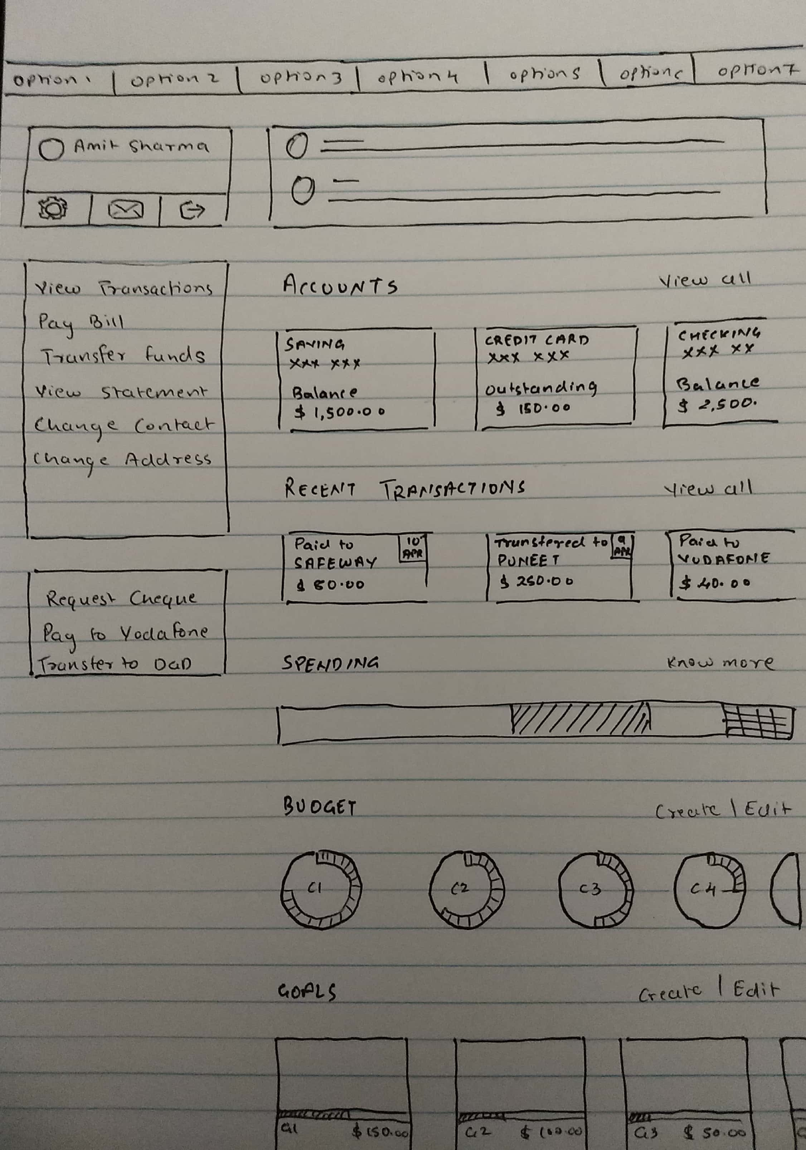
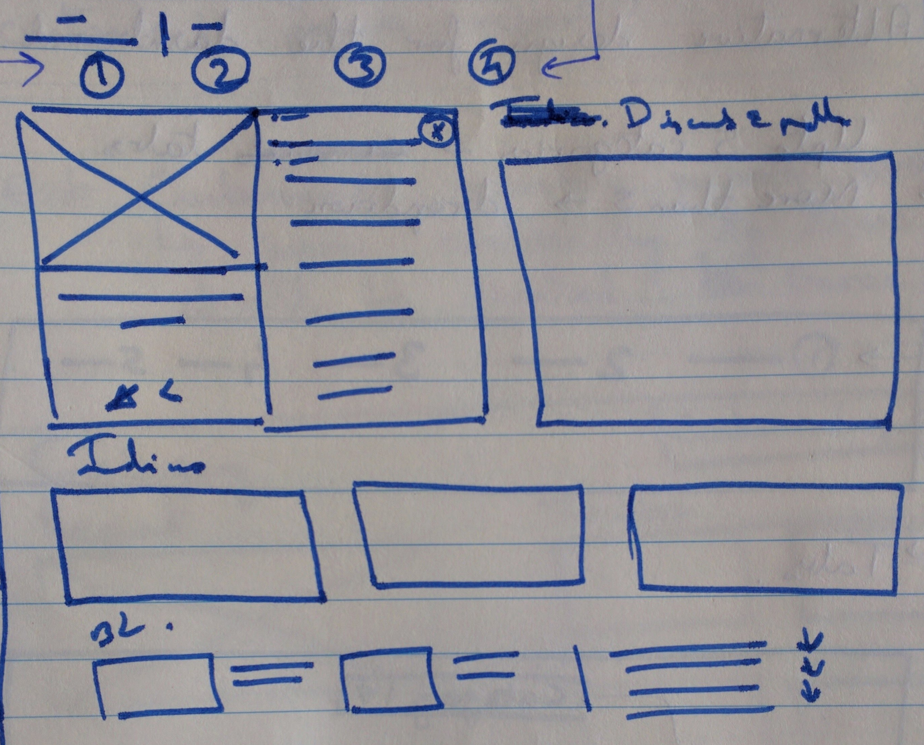
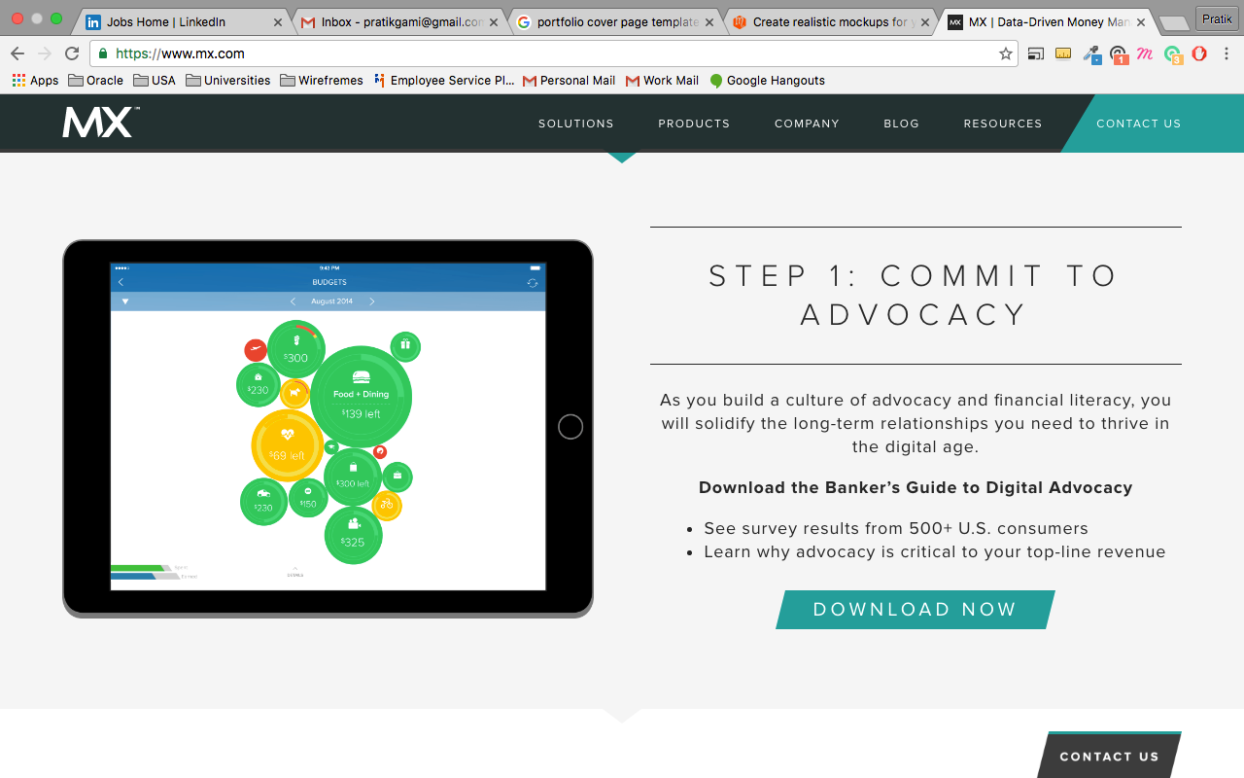
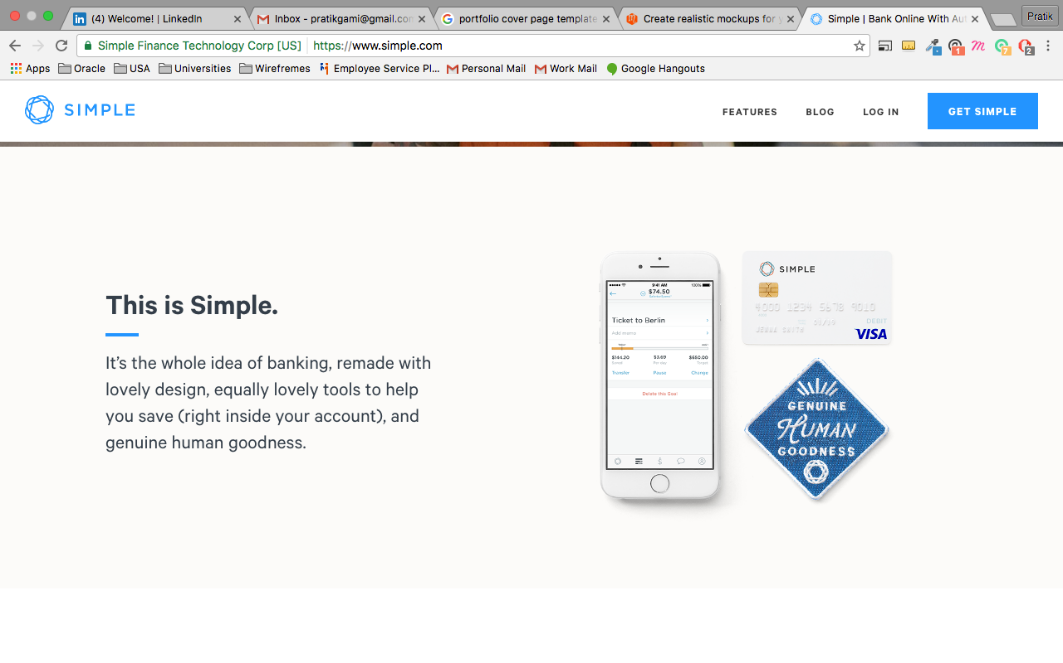
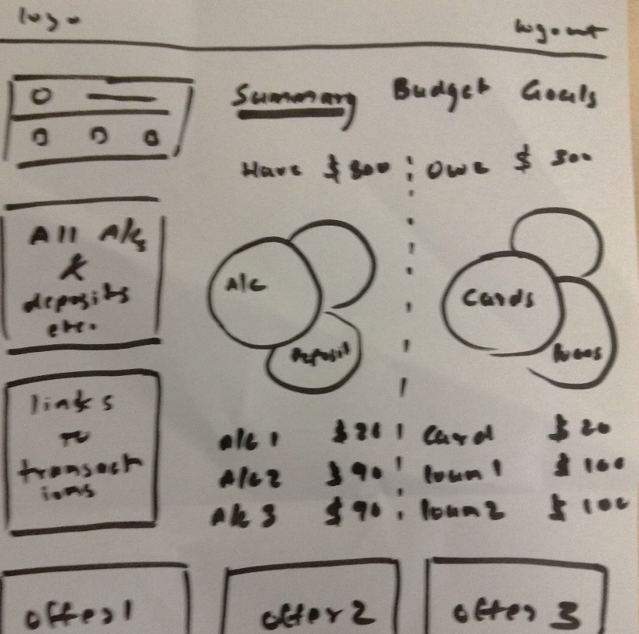
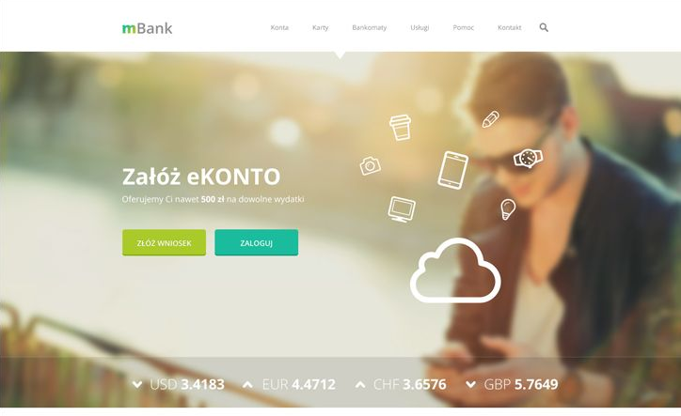
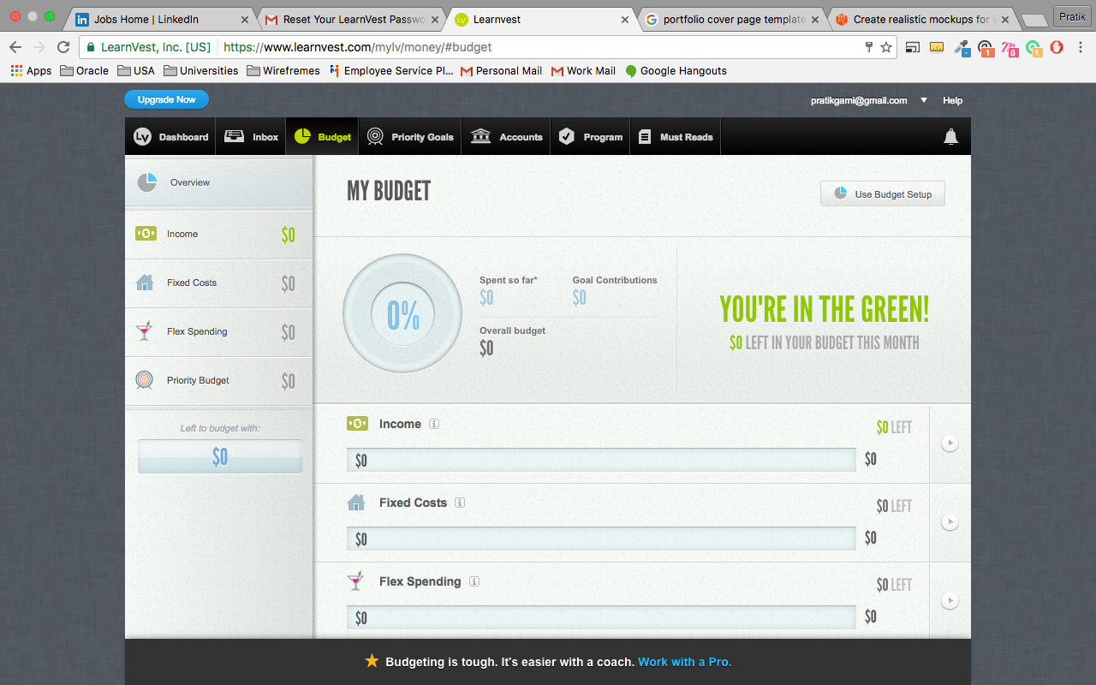
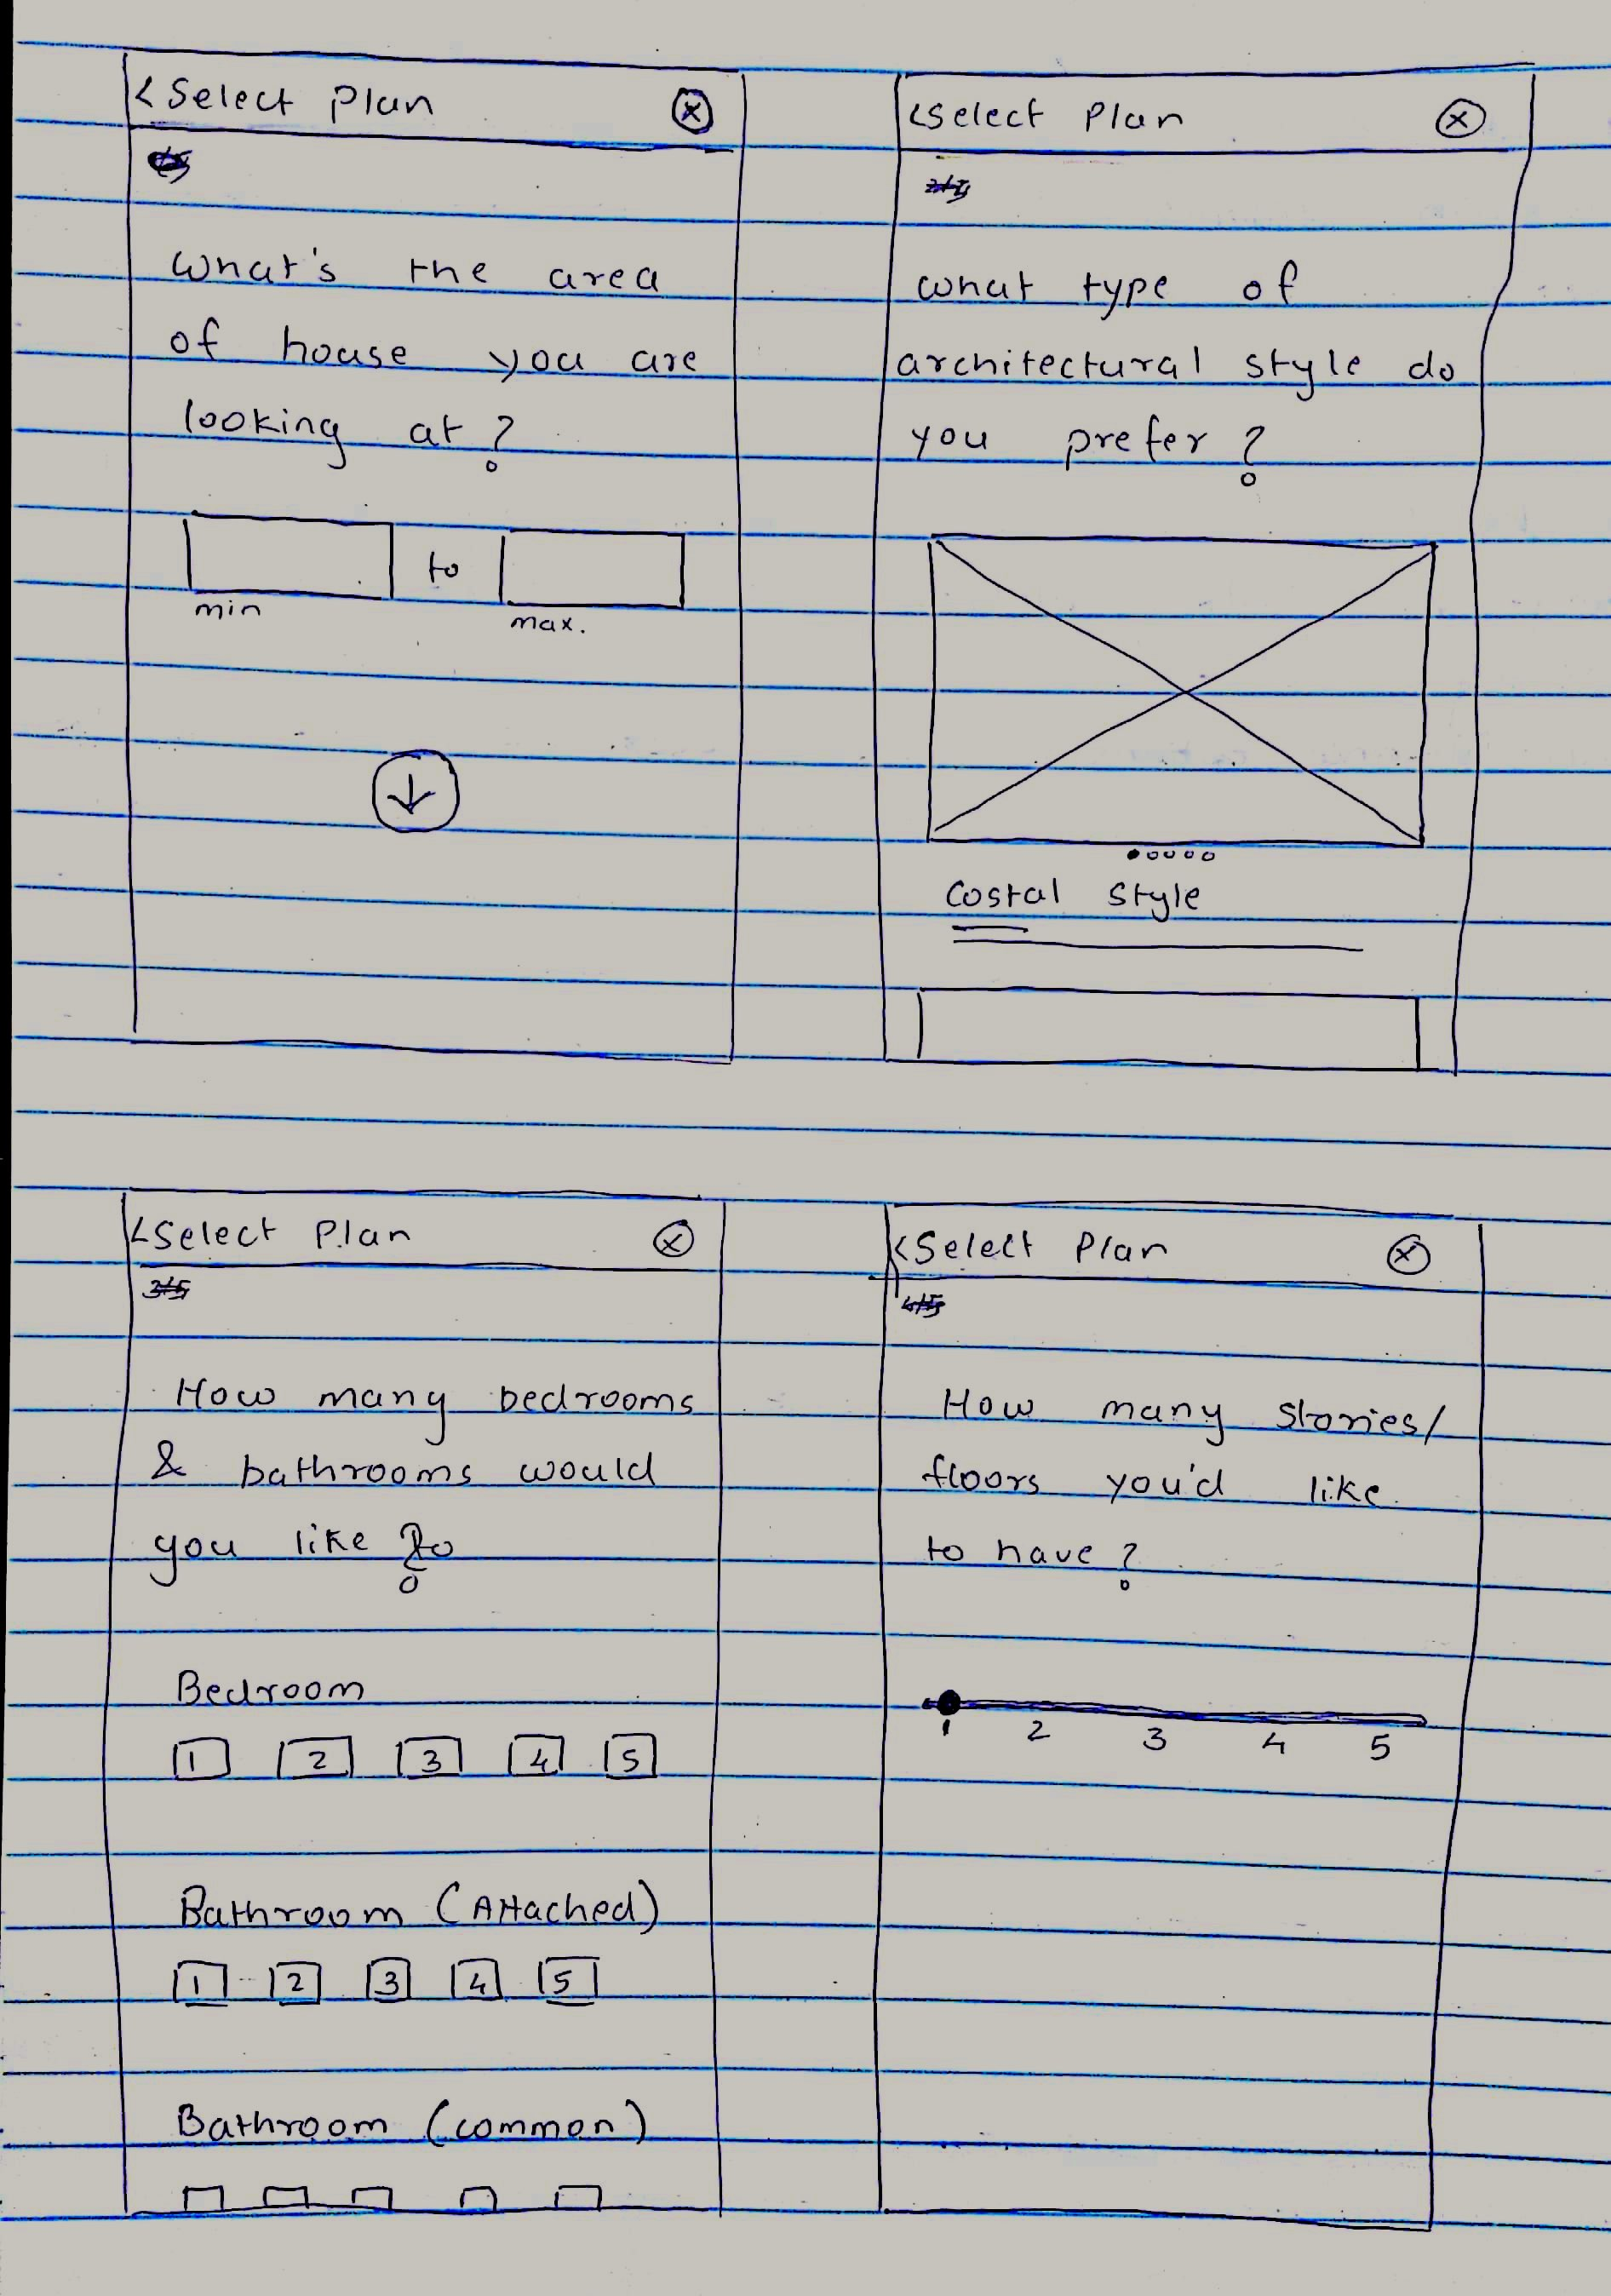
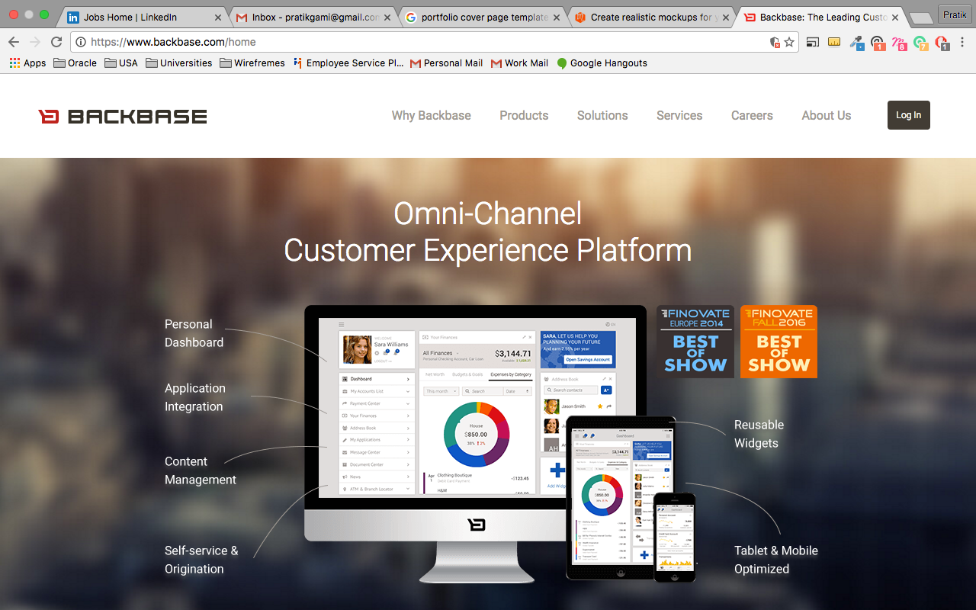
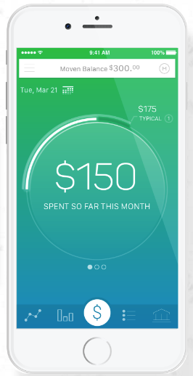
3.6
Inspirations & Concepts

Slide 13
3.7
Information Architecture
Level 1
Personal
Small Business
Corporate
Wealth Management
Level 2
Login
Register
Level 3
Dashboard
Surfaced key information and actions
Save
All account information and related actions
Borrow
All information and actions related to loans and credit cards
Invest
All information and actions related to Insurance and mutual funds
Learn
Calculators, rates, fees, other tools, knowledge centre
Get Help
Multiple avenues to find help – Contact us, community, FAQ, online chat, etc.
Level 4
Account Details
Transaction Flow
Product Showcase
Product Details

Slide 14
Origination Flow
3.8
Task Flows
Transaction Flow
Enquire Flow
Landing Page
Splash Screen
Landing Page
Splash Screen
Landing Page
Splash Screen
Login Screen
App Login Screen
Login Screen
App Login Screen
Login Screen
App Login Screen
Dashboard
Dashboard
Dashboard
Calculators
Transaction Wizard
Account Details
Product Showcase
Product Details
Confirmation
Help
Acquisition Form

Slide 15
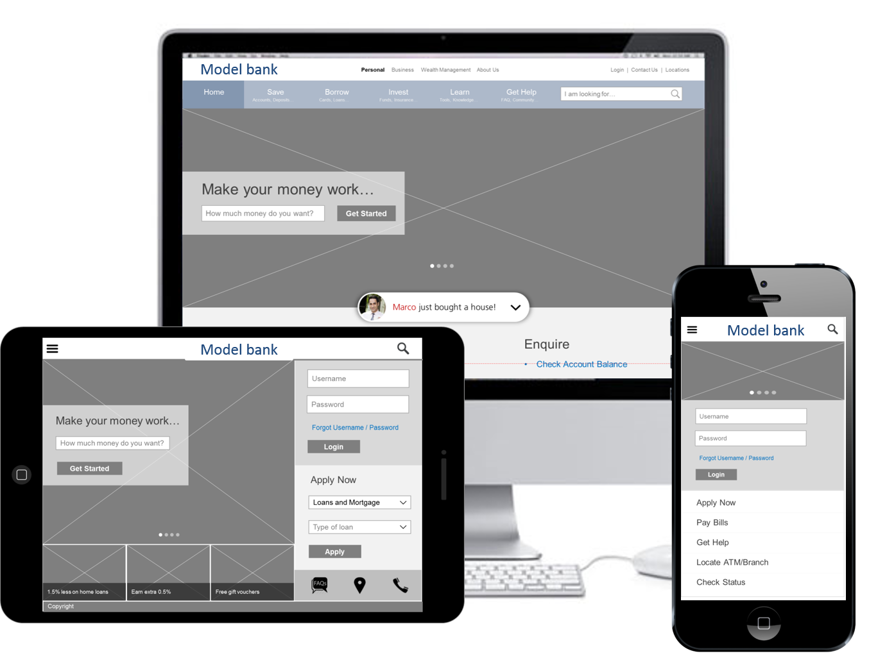
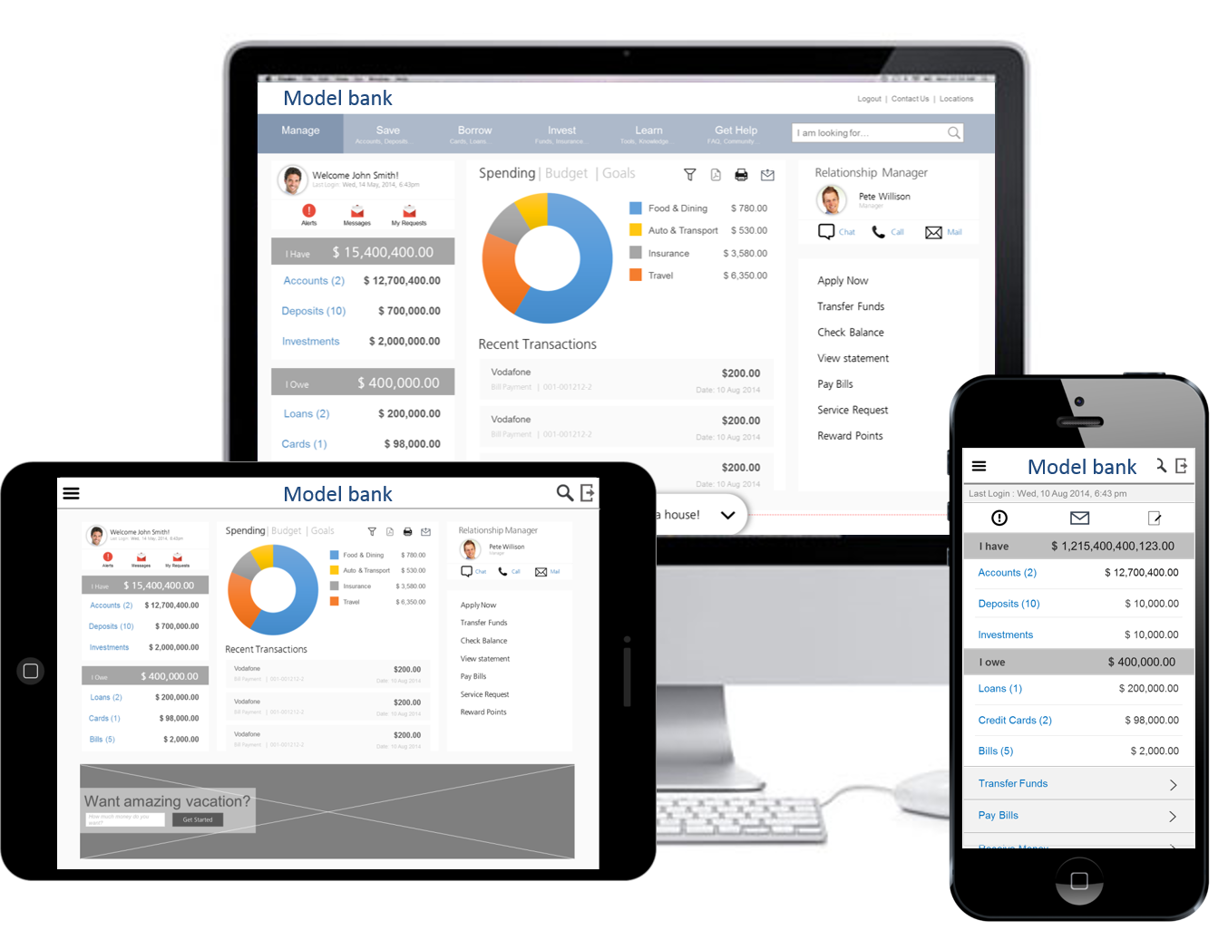
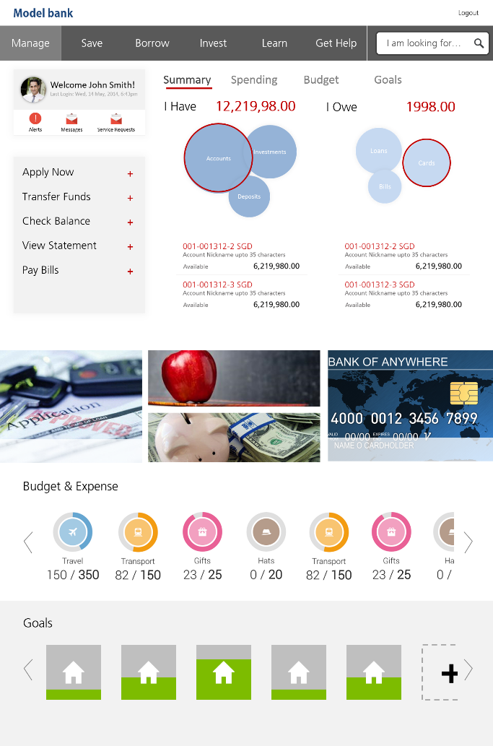
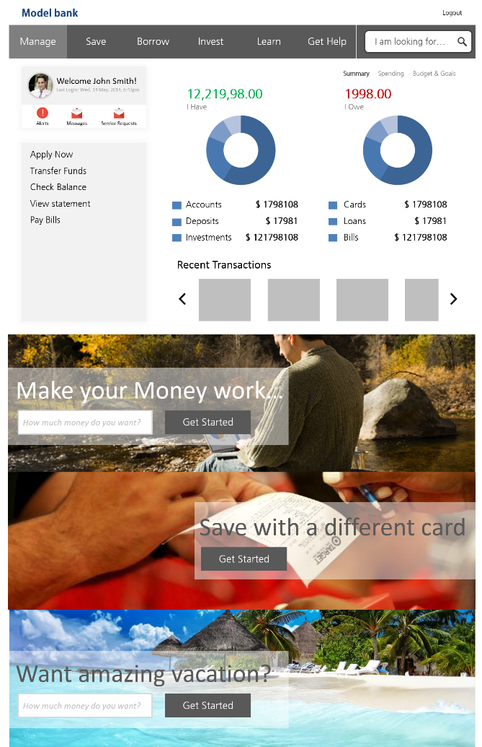
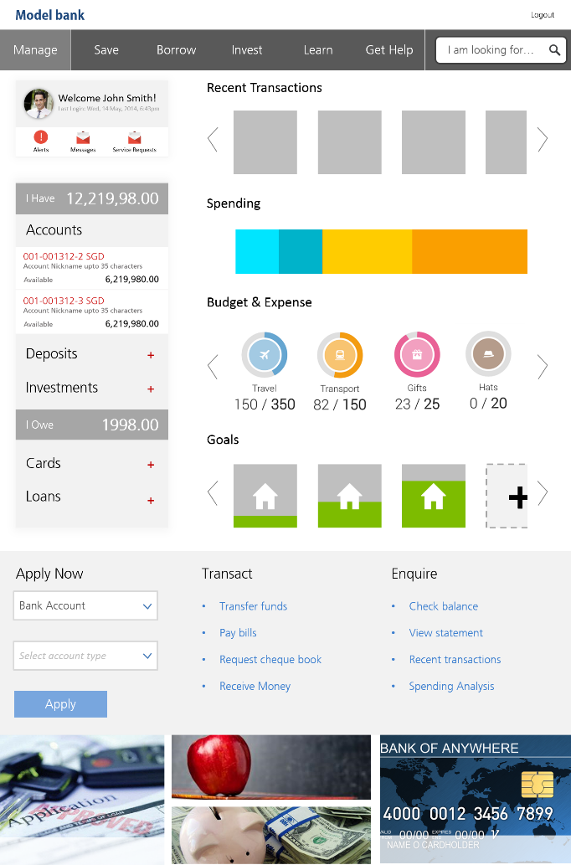
3.9
Design Iterations

Slide 16
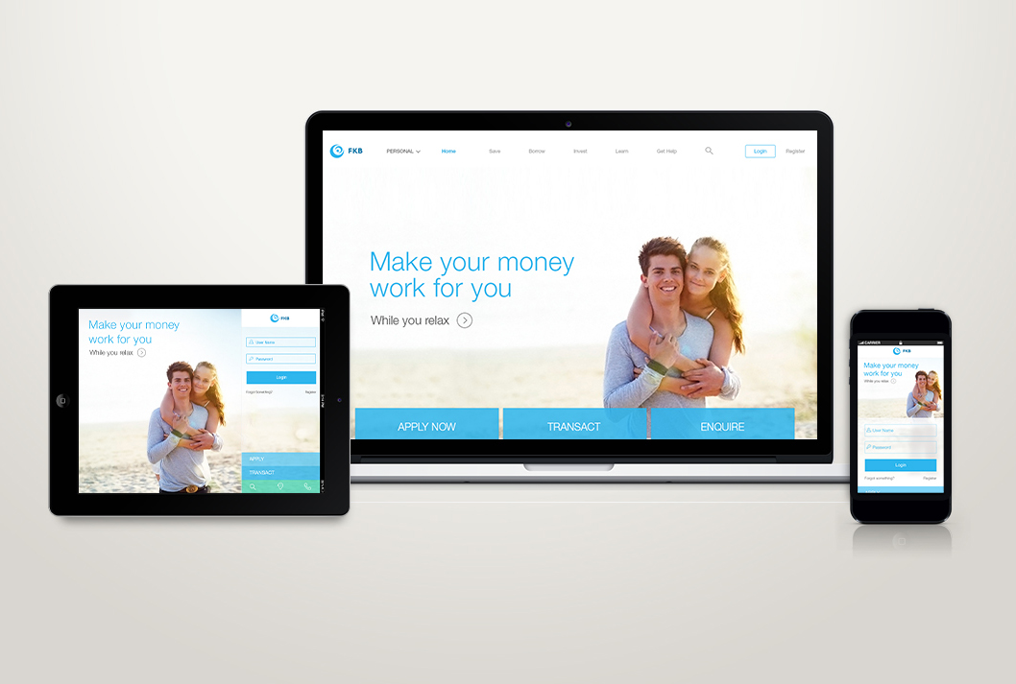
3.10
Final Design - Homepage

Slide 17
3.11
Final Design - Dashboard

Slide 18
PROJeCTS
4
Worked with number of companies and clients from various domains, located across the globe. Summary of few projects will be covered in the following slides.
CLIENT LIST:
Banks
Standard bank of South Africa
Development Bank of Singapore
ICICI Bank
IDFC Bank
Non Banking Financial Companies
L&T Finance
Fincare
Insurance Companies
L&T Insurance
Bharti AXA Health Insurance
Aditya Birla Life Insurance
Robotics and Production Line
ABB
Bosch
Software Companies
Oracle Financial Services Software
Infosys
Telecommunication Companies
T-Mobile
Airtel
E-commerce
Snapdeal

Slide 19
PROJeCTS
4
Designing for Artificial Intelligence
Interactive Voice Response System
Design Study
Paper 1: Pre-attentive processing
Paper 2: Prior knowledge and long-term memory
Paper 3: Metacognition in decision making
Paper 4: Working memory Designing for the semi-literates
Designing for the semi-literates
Expert Review (Usability Assessment)
Talent Recruit
American Express, India
Designing for Efficiency
Quick Guide to UX Strategy
Designing for Disruption
Write-ups
How do usability practitioners categorize and rate usability problems?
Reliability of usability evaluation methods
Color, trust, and online store choice: A narrative review

Slide 20
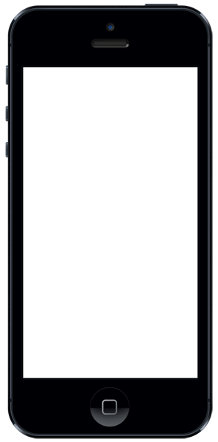
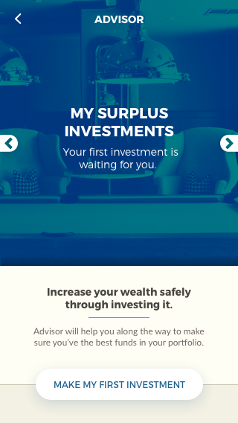
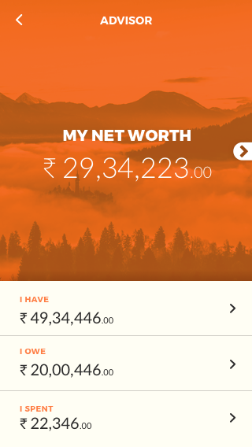
4.1
Designing for Artificial Intelligence
Investment Management
The client wanted to build an investment management platform with artificial smarts to provide financial advises to the users.
As part of this engagement, we carried out user research to understand the investments barriers faced buy people, followed by competitive analysis and stakeholder interview.
Modular designs were conceptualized and created, keeping the AI’s contextual nature in mind.

Slide 21




4.2
Interactive Voice Response System
Designed and tested script/menu for the zero UI, Interactive voice response (IVR) banking system at Standard Bank’s usability lab in Johannesburg, South Africa.
Stakeholder Interview
Literature Review
Data Analysis & Design
Usability Testing
Requirements were gathered from stakeholders to determine the function/feature list (e.g. check account balance, generate OTP, etc) for the IVR menu.
Literature review was used to settle the ‘broad versus deep auditory menu’ debate. Based on evidence from existing research, we decided to go with broad menu structures.
Customer support data was used to decide the order of functions/features. Most frequently used functions were placed at the top of the list.
Scripts were tested iteratively to validate the design and to decide input method (speech or key-in); each iteration involved testing with 5 participants followed by redesign.

Slide 22
4.3
Design Study
The purpose of design study is to understand the human factors that underlie the user's interaction with the product. The reviews include applied theories relevant to the design of information products, training programs, or user interface designs. The study also reviews products keeping in mind it’s compatible with the strengths and weaknesses of the user's information processing systems.
Paper 1: Pre-attentive processing Design case: ‘SHARP Advance D.A.L. EL-531XC’ calculator
Paper 2: Prior knowledge and long-term memory Design case: Prototyping tool ‘Axure’
Paper 3: Metacognition in decision making Design case: L&T Mutual Funds’ website
Paper 4: Working memory Design case: Online investment management platform ‘ICICIDirect’

Slide 23

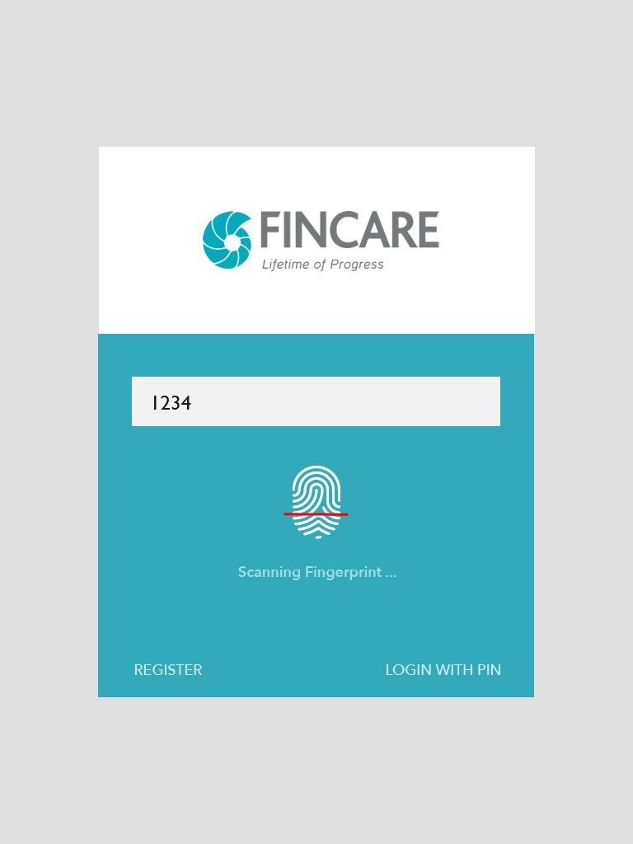
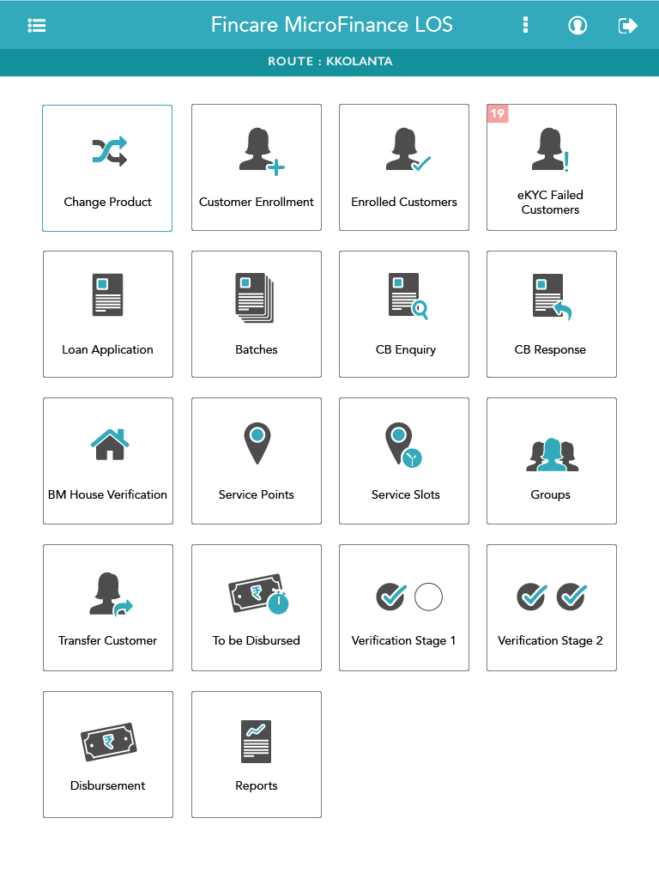
4.4
Designing for the semi-literates
Microfinance
The client wanted to re-vamp their existing tablet app used by their employees to sanction micro finance loans.
The employees/users of this app were semi literate 10-12 pass rural population.
Icon and instruction based design with simple, step-by-step flow for easy navigation and higher success ratio.

Slide 24
4.5
Expert Review (Usability Assessment)
Expert review provides an immediate tactical analysis of the user experience of your Web site, Web application, GUI application, or Intranet. It gives a prioritized list of changes to correct confusing elements of the current design. The result is a redesign solution that leads to an enhanced user experience.
Purpose of expert review
Identify key trouble spots
Provide short-term fixes
Direct for long-term improvement
Uncover issues before going for Usability Testing
What expert review isn’t
Is not a comprehensive review
It is not based on research with actual users
It doesn’t cover the entire breadth and depth of the site's content
Projects
Expert Review 1: Talent Recruit
Expert Review 2: American Express, India

Slide 25
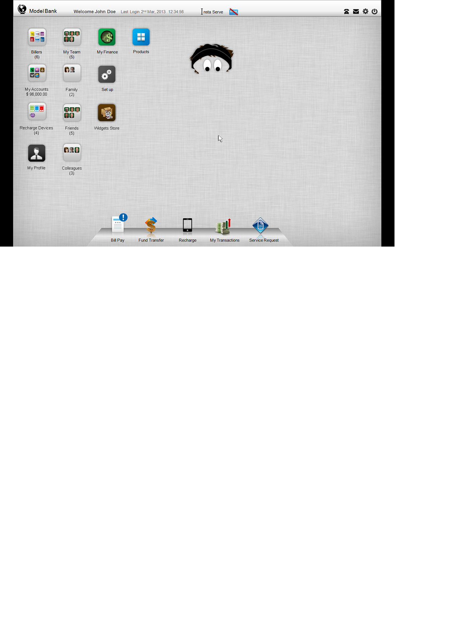
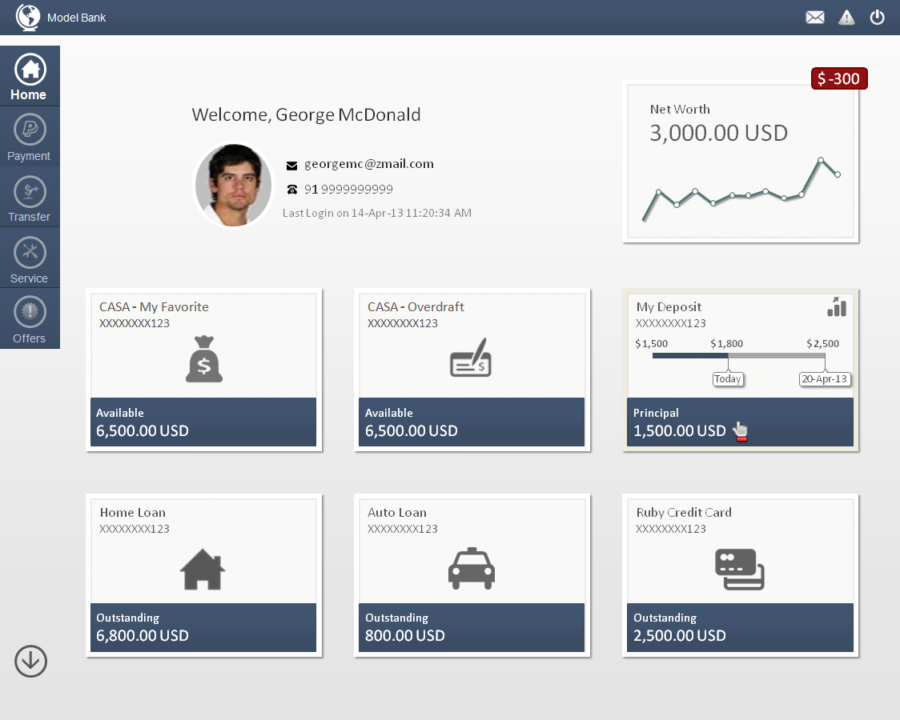
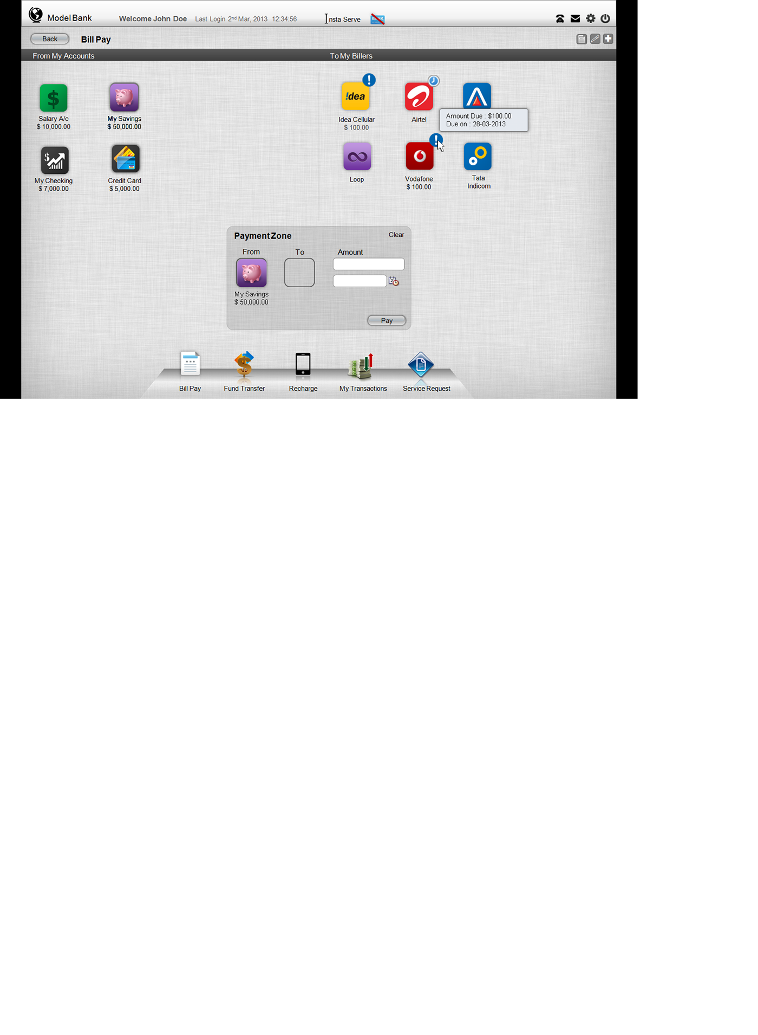
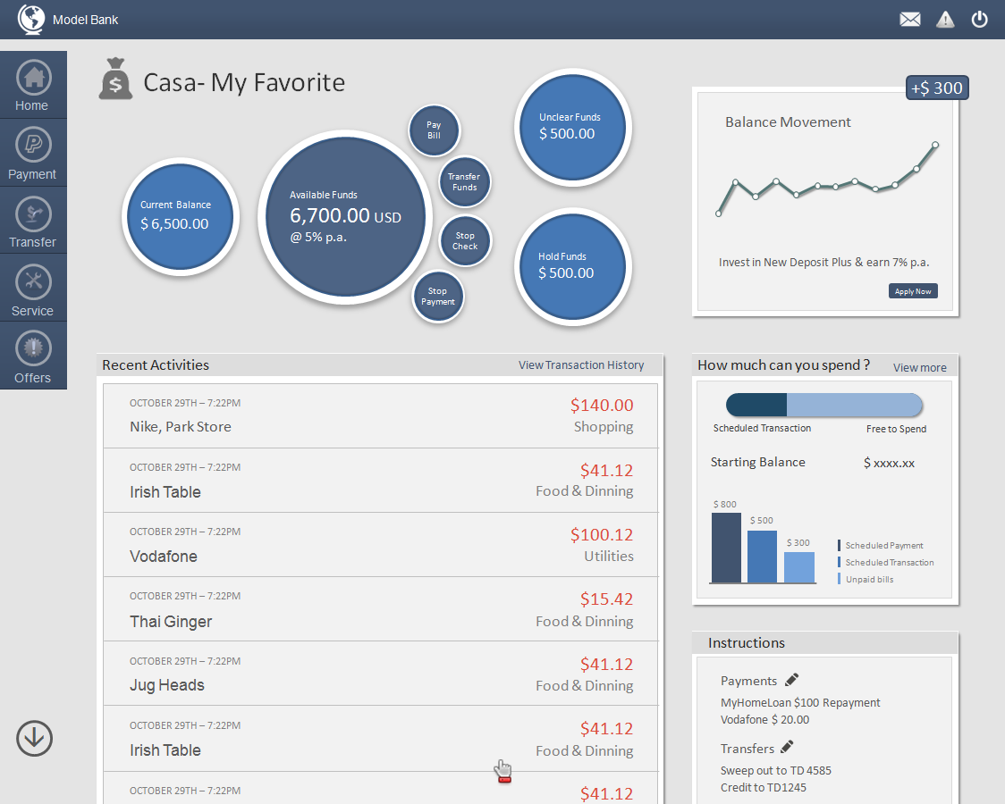
4.6
New Generation Online Banking
Designing for Disruption
Reimagined the concept of digital banking. Introduced many user friendly functionalities and experience delights for transferring money, bill payment, Enquiry, Personal finance management, etc.

Slide 26
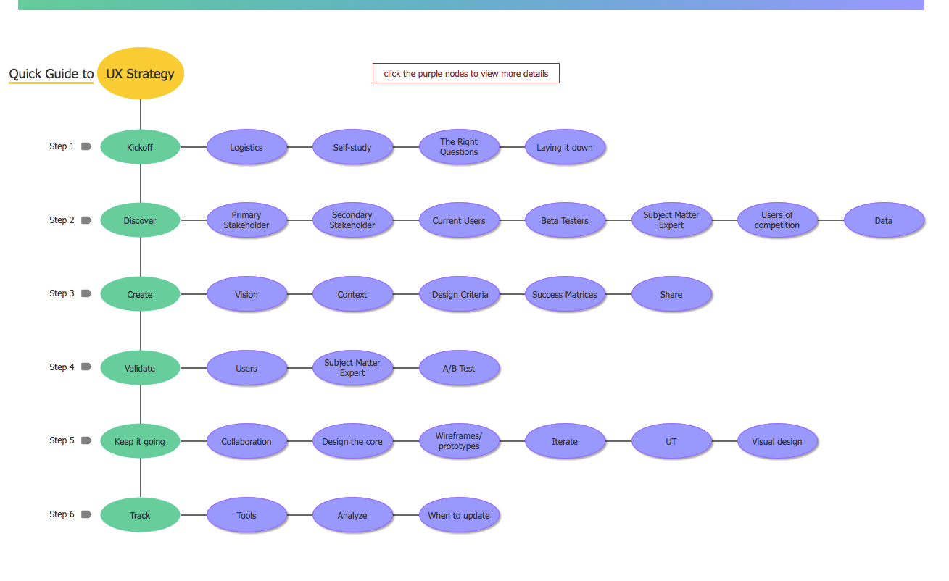
4.7
Quick Guide to UX Strategy
After reading the book 'Field Guide to UX Strategy' by Robert Hoekman Jr., I found it so interesting and informative that I wanted to use it for my future projects. However, I figured it would be time-consuming and cumbersome to refer a 100-page book, time and again, while working on a project. In order to make it more manageable and convenient, I decided to convert it into a quick, go-to guide which I could refer to, no matter at what stage of the project I was is in.
Here's the link to my interactive 'Quick Guide to UX Strategy':https://zqjh9b.axshare.com/#c=2

Slide 27
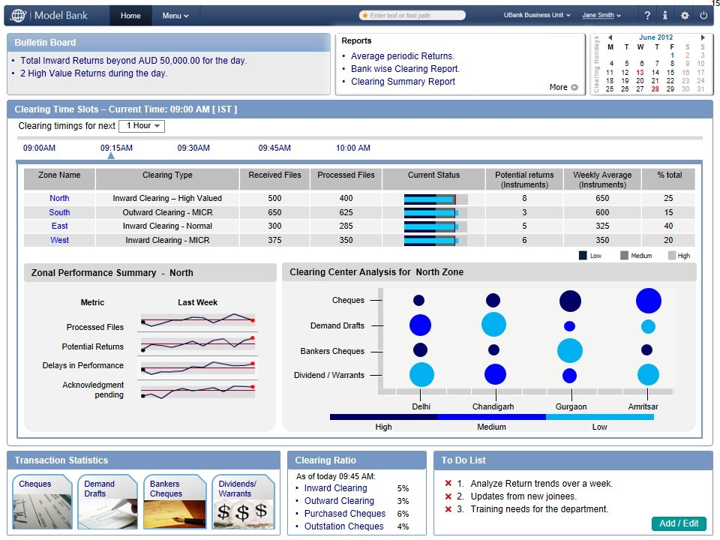
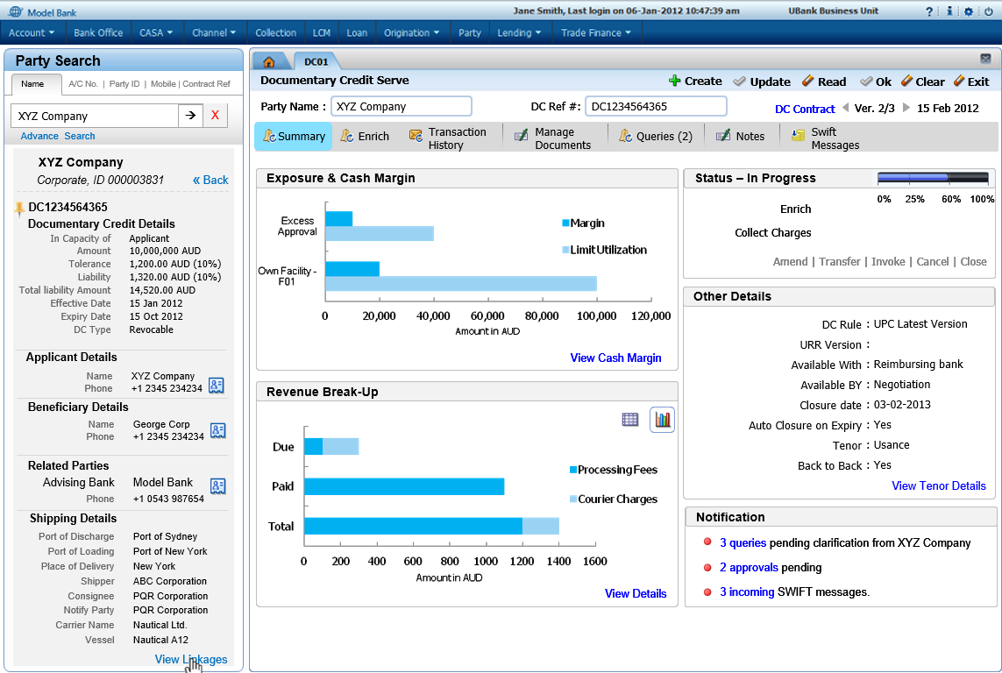
4.8
Core Banking
Designing for Efficiency
Re-engineered long, complex trade finance, account origination and loan servicing processes which went live and improved efficiencies up to 40% in the first release.
According to the statistics received from client
Ignite went live in 179 client branches in Australia
It took as little as 11 minutes to apply for unsecured loans
98% of users understood what they need to do differently in their roles
96% of the users were aware where to access loan products from
78% of the users are looking forward to future releases

Slide 28
4.9
Write-ups
The purpose of these write-ups is to discuss the strengths and weaknesses of particular research designs by critiquing research methodologies and methods from journal and practitioner publications. The write-ups also discusses various strategies to mitigate the weaknesses and provides alternate approach to the research design in context.
Write-up 1: How do Usability Practitioners Categorize and Rate Usability Problems?
Write-up 2: Reliability of usability evaluation methods
Write-up 3: Color, trust, and online store choice: A narrative review

Slide 29
ACADEMIC PROJeCTS
5
Design Study
Paper 1: Pre-attentive processing
Paper 2: Prior knowledge and long-term memory
Paper 3: Metacognition in decision making
Paper 4: Working memory
Quick Guide to UX Strategy

Slide 30
Thank You
Website: https://pratikgami.github.io/

